Slide 1
THE WORD OF GOD
Saturday Service 19 Jul 2014
Cecil Ang

Slide 2
Quotations
“One hundred years from my day there will not be a Bible in the earth except one that is looked upon by an antiquarian curiosity seeker.” Voltaire (1694-1778)
The grass withers and the flowers fall, but the word of our God endures forever. Isaiah 40:8 NIV

Slide 3
The Bible Codes
Genesis 1:1-4. Biblia Hebraica from Kittel's edition (BHK) 1909. Four letters, 50-letter apart, starting from the first taw on the first verse, form the word תורה (Torah).

Slide 5
“Yeshua is My name” (Yeshua Shmi)
Yet it was the Lord’s will to crush him and cause him to suffer, and though the Lord makes his life an offering for sin, he will see his offspring and prolong his days, and the will of the Lord will prosper in his hand.
Is 53:10 NIV

Slide 6
TEXT | ELS | ENCODED
Genesis | Every 521st letter | Yeshua Yakhol – “Jesus is able”
Lev 21:10-12 Instructions for holy priesthood | Every 3rd letter | Hain dam Yeshua – “Behold! The blood of Yeshua”
Dan 9:25-27 Daniel’s 70 weeks | Every 26th letter | Yeshua
Zech 11:12 Price of betrayal | Every 24th letter | Yeshua

Slide 7
INTRODUCTION
Features | Old Testament | New Testament
Number of books | 39 | 27
Language(s) written | Hebrew & parts in Aramaic | Greek
Authors | About 40 spanning over a 1600-year period
Events chronicled | Creation to 400 years before Christ | Prior to Christ’s birth to end time events
Time period | Abt 2500 BC to 400 BC | Abt 4 BC to 100 AD
Contents | Law History Wisdom Major Prophets Minor Prophets | Gospels History (Acts) Epistles Revelation

Slide 8
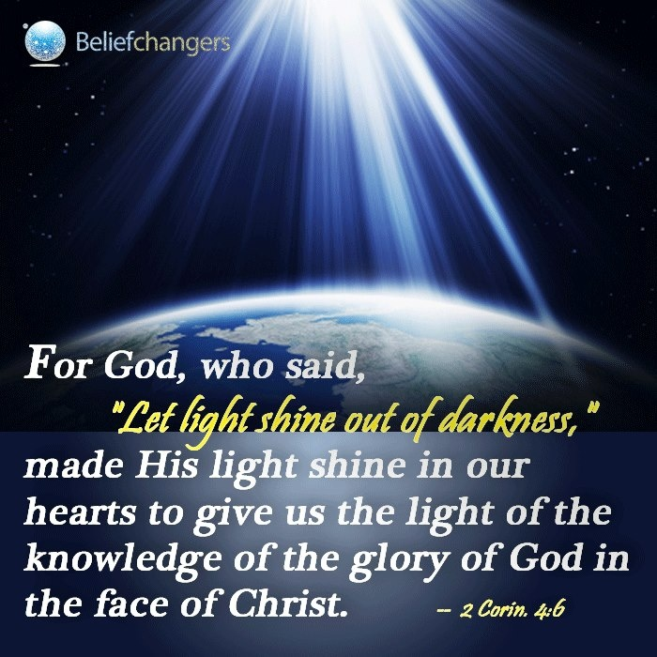
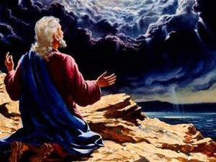
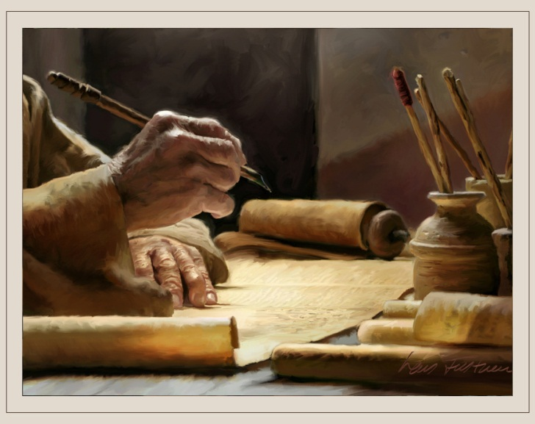
HOW WAS THE BIBLE CONSTITUTED?
Biblical writers had revelation, inspiration and at times, illumination.

Slide 9
REVELATION
Revelation concerns the communication of truth not discovered by natural reason.
God’s revelation to mankind can be in the form of direct verbal or non-verbal transmission.
God has revealed Himself through His Works and His Words

Slide 10
God’s Works
For since the creation of the world God’s invisible qualities—his eternal power and divine nature—have been clearly seen, being understood from what has been made, so that people are without excuse. Rom 1:20 NIV
Then Moses and the Israelites sang this song to the Lord: “I will sing to the Lord, for he is highly exalted. Both horse and driver he has hurled into the sea.”
Ex 15:1 NIV

Slide 11
God’s Words
The word of the Lord came to me, saying, “Before I formed you in the womb I knew you, before you were born I set you apart; I appointed you as a prophet to the nations.” Jer 1:4-5 NIV
For I received from the Lord what I also passed on to you: The Lord Jesus, on the night he was betrayed, took bread. 1 Cor 11:23 NIV

Slide 12
INSPIRATION
Inspiration concerns the influence of the Holy Spirit on the mind and soul of man to record the truths of God.
All Scripture is God-breathed and is useful for teaching, rebuking, correcting and training in righteousness, so that the servant of God may be thoroughly equipped for every good work. 2 Tim 3:16-17 NIV
We also have the prophetic message as something completely reliable, and you will do well to pay attention to it, as to a light shining in a dark place, until the day dawns and the morning star rises in your hearts. Above all, you must understand that no prophecy of Scripture came about by the prophet’s own interpretation of things. For prophecy never had its origin in the human will, but prophets, though human, spoke from God as they were carried along by the Holy Spirit. 2 Pet 1:19-21 NIV

Slide 13
INSPIRATION
Many have undertaken to draw up an account of the things that have been fulfilled among us, just as they were handed down to us by those who from the first were eyewitnesses and servants of the word. With this in mind, since I myself have carefully investigated everything from the beginning, I too decided to write an orderly account for you, most excellent Theophilus, so that you may know the certainty of the things you have been taught. Luke 1:1-4 NIV
The other events of Jeroboam’s reign, his wars and how he ruled, are written in the book of the annals of the kings of Israel. As for the other events of Rehoboam’s reign, and all he did, are they not written in the book of the annals of the kings of Judah? 1 Kg 14:19, 29 NIV

Slide 14
ILLUMINATION
Illumination describes the process of the Holy Spirit enlightening man’s understanding to believe and receive God’s revelation.
I warn everyone who hears the words of the prophecy of this scroll: If anyone adds anything to them, God will add to that person the plagues described in this scroll. And if anyone takes words away from this scroll of prophecy, God will take away from that person any share in the tree of life and in the Holy City, which are described in this scroll. Rev 22:18-19 NIV
I keep asking that the God of our Lord Jesus Christ, the glorious Father, may give you the Spirit of wisdom and revelation, so that you may know him better. I pray that the eyes of your heart may be enlightened in order that you may know the hope to which he has called you, the riches of his glorious inheritance in his holy people. Eph 1:17-18 NIV

Slide 15
Our Responsibility
Do your best to present yourself to God as one approved, a worker who does not need to be ashamed and who correctly handles the word of truth. 2 Tim 2:15 NIV
Now the Berean Jews were of more noble character than those in Thessalonica, for they received the message with great eagerness and examined the Scriptures every day to see if what Paul said was true. Ac 17:11 NIV

Slide 16
Authorship of Scripture
“The dual authorship of Scripture is an important truth to be carefully guarded. On the one hand, God spoke, revealing the truth and preserving the human authors from error, yet without violating their personality. On the other hand, men spoke, using their own faculties freely, yet without distorting the divine message.”
John Stott in Understanding the Bible

Slide 17
Old Testament Canon
Acceptable list of books
Completed by 400 BC
Jesus and apostles recognised many OT books as authoritative
Council of Jamnia, 90 AD
He said to them, “This is what I told you while I was still with you: Everything must be fulfilled that is written about me in the Law of Moses, the Prophets and the Psalms.”
Lk 24:44 NIV

Slide 18
Apocrypha
Reason for the rejection
They abound in historical, geographical and chronological errors, at times contradicting themselves, the Bible and history.
The teach doctrines which are false and foster practices which are at odds with inspired Scripture eg. lying is sanctioned, suicide and assassination are justified.
They were written in the 400 years between Malachi and John the Baptist when there were no inspired prophetic utterances.
They were never quoted by Jesus and the apostles.

Slide 19
New Testament Canon
Circulation of pseudo-epistles
Synod of Carthage in 397 AD
5 guiding principles used:
Is it authoritative? Does it come with the divine “thus saith the Lord”?
Is it prophetic? Was it written by an apostle or a close associate?
Is it authentic? The fathers had the policy of “if in doubt, throw it out”.
Is it dynamic? Did it come with the life-transforming power of God?
Was it received, collected, read and used? Was it accepted by the church at that time?

Slide 20
Bible Translations
Word for Word | Dynamic equivalence (updates matters of lang, grammar & style) |  | Ideas for Ideas
KJV (1611) NASB (1971) | RSV (1952) NIV (1973) NKJV (1982) NAB (1970) | GNB JB, NEB | LB (1971) The MSG (1993-2002)
By 3 BC, the Old Testament books were translated into Greek by a team of 70 Jewish scholars - Septuagint In 382 AD, Jerome's Latin Vulgate manuscripts produced and used for the next 1000 years (contain all 80 Books); RC declaration in 600 AD
By 500 AD, Scriptures have been translated into more than 500 languages
Late 14th century, John Wycliffe & his followers translated first English version of the Bible from the Vulgate
In 1611 AD, the King James Bible printed (all 80 Books). The Apocrypha was officially removed in 1885, leaving only 66 Books.
By 2012, the Bible has been translated into more than 2700 languages.

Slide 21
Psalm 138:2
I will worship toward thy holy temple, and praise thy name for thy lovingkindness and for thy truth: for thou hast magnified thy word above all thy name. (KJV)
I will bow down toward Your holy temple and give thanks to Your name for Your lovingkindness and Your truthª; For You have magnified Your word^{b} according^{c} to all Your name. (NASB)
I will bow down toward your holy temple and will praise your name for your love and your faithfulness, for you have exalted above all things your name and your word. (NIV)
I will face your holy temple, bow down, and praise your name because of your constant love and faithfulness, because you have shown that your name and your commands are supreme. (GNB)
I face your Temple as I worship, giving thanks to you for all your loving-kindness and your faithfulness, for your promises are backed by all the honor of your name. (LB)

Slide 22
Our Yes and Amen in Christ!
But as God is faithful, our word to you is not yes and no. For the Son of God, Christ Jesus, who was preached among you by us—by me and Silvanus and Timothy—was not yes and no, but is yes in Him. For as many as are the promises of God, in Him they are yes; therefore also through Him is our Amen to the glory of God through us.
2 Cor 1:18-20 NASB

Slide 23
Promises of God
If you declare with your mouth, “Jesus is Lord,” and believe in your heart that God raised him from the dead, you will be saved. Rom 10:9 NIV
He sent His word and healed them, and delivered them from their destructions. Ps 107:20 NKJV

